Slide 1

ILP 2021 – W2S2 If/Elif/Else statements, While/Break statements
Matthieu DE MARI – Singapore University of Technology and Design

Slide 2
Outline (Week2, Session2 – W2S2)
The if statement
The elif statement
The else statement
Dead code and code structure
Nested ifs
While statements
Infinite looks and how to kill them
The break statement
(If time allows, recursion!)

Slide 3
Nested if structures
Definition (nested if structure): A nested if structure is a structure which includes one or multiple if statement(s), inside another if statement.

Slide 4
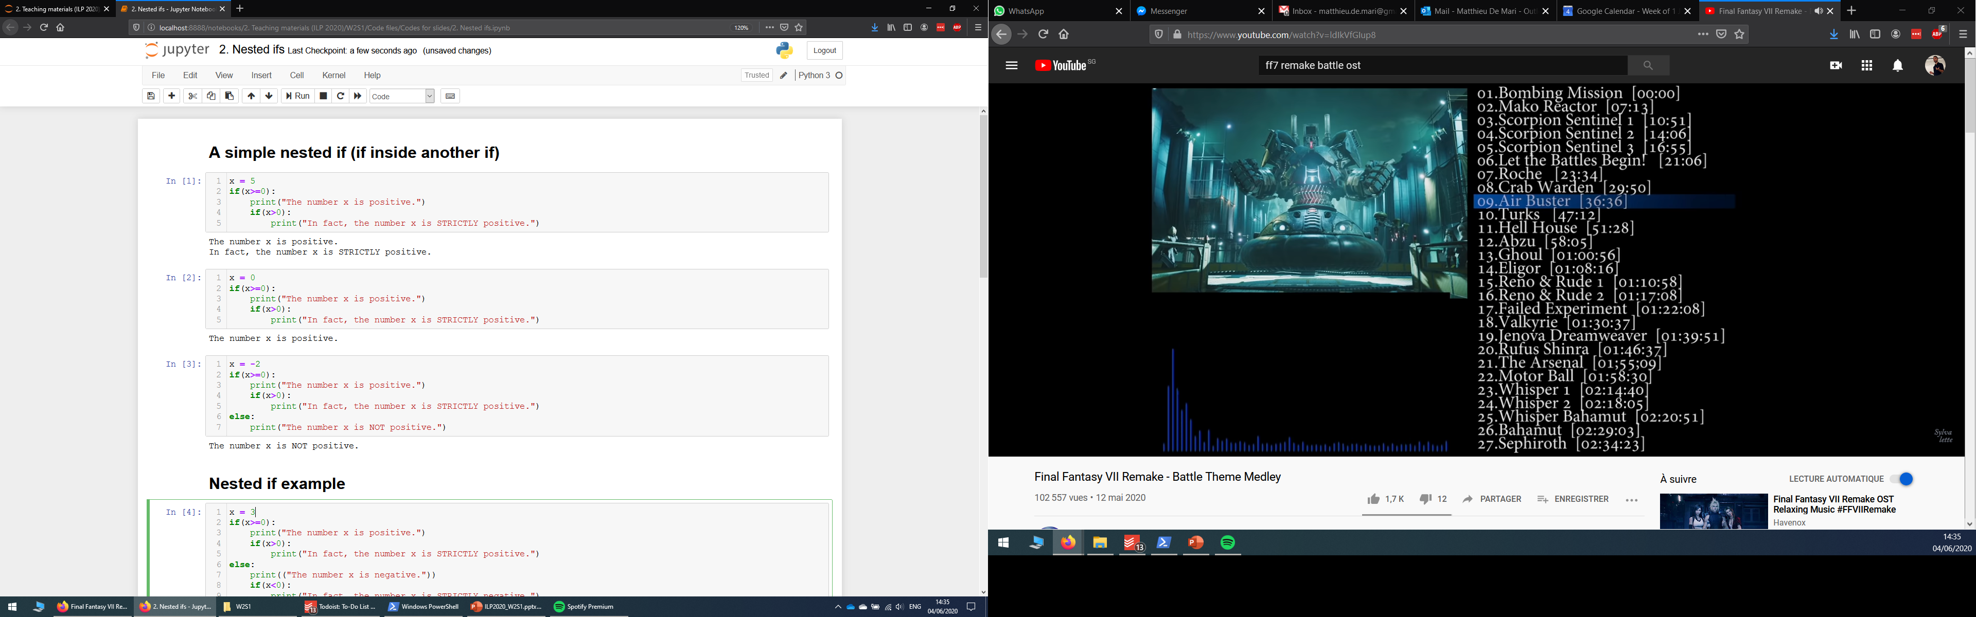
Nested if structures
Definition (nested if structure): A nested if structure is a structure which includes one or multiple if statement(s), inside another if statement.
These are typically used to check additional conditions, based on whether another condition has been satisfied or not.

Slide 5
Nested if structures
Definition (nested if structure): A nested if structure is a structure which includes one or multiple if statement(s), inside another if statement.
These are typically used to check additional conditions, based on whether another condition has been satisfied or not.
Each if might have its own elif/else statements, placed on the same indentation level.

Slide 6
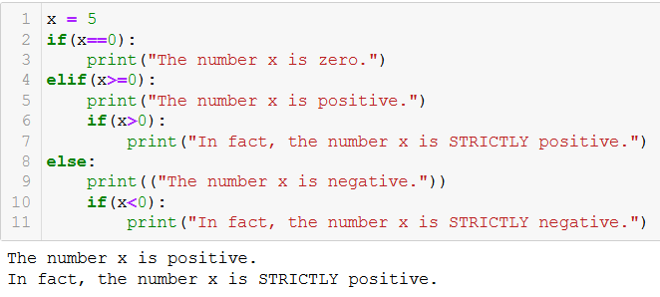
Nested if structures

Slide 7
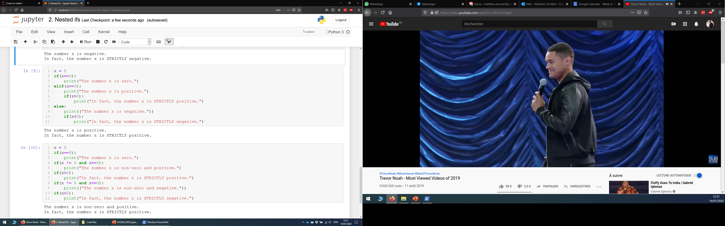
Nested if structures vs. combined conditionals
Nested if structures can, most of the time, be rewritten with combined conditionals (using and/or Boolean operators).

Slide 8
Nested if structures vs. combined conditionals
Nested if structures can, most of the time, be rewritten with combined conditionals (using and/or Boolean operators).
For instance, both structures on the right are equivalent.

Slide 9
Nested if structures vs. combined conditionals
Nested if structures can, most of the time, be rewritten with combined conditionals (using and/or Boolean operators).
For instance, both structures on the right are equivalent.
Personal preference: Whenever possible, try to avoid the nested if structures. They are often overly complicated and prone to errors in designing the code.

Slide 10
Activity 3 - Race and class check
Write a function character_creation(), according to the following requirements.
The function will receive two parameters: user_race and user_class.
For simplicity, only three races are available: Human, Elf, and Dwarf.
For simplicity, only four classes are available: Warrior, Hunter, Mage and Priest.
Humans can play all classes.
Elves cannot be warriors.
Dwarves cannot be mages or priests.
The function should not return anything.
It should print "You cannot play a character that is ...{race} and ...{class}.", with blanks filled accordingly, if the combination of user_race and user_class is not acceptable.
Not acceptable here means that its race and/or class is not among the ones listed above, or the combination is not permitted, as listed above.
If the combination is valid, it should print "Your character's race is ...{race} and your character's class is ...{class}.", with blanks filled accordingly.

Slide 11
The while statement
The while statement is another type of conditional structure.

Slide 12
The while statement
The while statement is another type of conditional structure.
The if statement is the simplest conditional structure.
How it works:
If the Boolean condition specified for the if statement is True, then execute the block of code inside the if statement.
If the Boolean condition is False, ignore the block of code in the if statement.
Once we are done executing the code in if (or ignoring it), move on to the next (non-indented) line.

Slide 13
The while statement
The while statement is another type of conditional structure.
How it works:
If the Boolean condition specified for the while statement is True, then execute the block of code inside the while statement.
If the Boolean condition is False, ignore the block of code in the while statement.
The if statement is the simplest conditional structure.
How it works:
If the Boolean condition specified for the if statement is True, then execute the block of code inside the if statement.
If the Boolean condition is False, ignore the block of code in the if statement.
Once we are done executing the code in if (or ignoring it), move on to the next (non-indented) line.

Slide 14
The while statement
The while statement is another type of conditional structure.
How it works:
If the Boolean condition specified for the while statement is True, then execute the block of code inside the while statement.
If the Boolean condition is False, ignore the block of code in the while statement.
Once we are done executing the code in while, move back to the while statement, and repeat until the condition is no longer True.
The if statement is the simplest conditional structure.
How it works:
If the Boolean condition specified for the if statement is True, then execute the block of code inside the if statement.
If the Boolean condition is False, ignore the block of code in the if statement.
Once we are done executing the code in if (or ignoring it), move on to the next (non-indented) line.

Slide 15
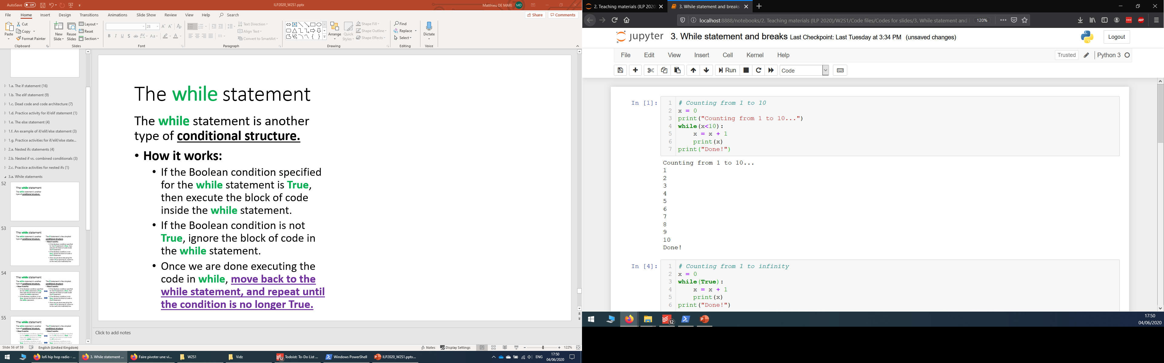
The while statement
The while statement is another type of conditional structure.
How it works:
If the Boolean condition specified for the while statement is True, then execute the block of code inside the while statement.
If the Boolean condition is False, ignore the block of code in the while statement.
Once we are done executing the code in while, move back to the while statement, and repeat until the condition is no longer True.

Slide 16
Architectures: if vs. while
Is condition in the while statement True?
Yes
No
Execute the code inside the if block
Move on to the next non-indented line of code
Is condition in the if statement True?
Yes
No
Execute the code inside the if block
Move on to the next non-indented line of code

Slide 17
Infinite loops
The while statement repeats a condition until it is no longer True.

Slide 18
Infinite loops
The while statement repeats a condition until it is no longer True.
This means that there should be a clear process that makes your condition no longer True, at some point.

Slide 19
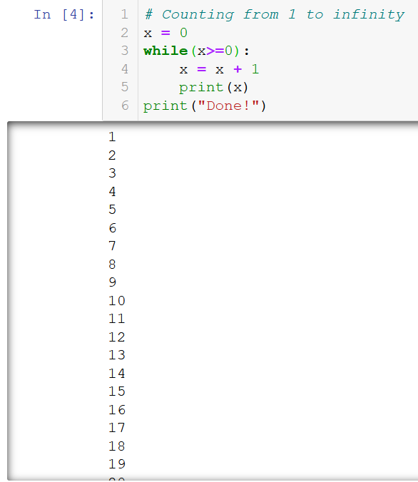
Infinite loops
The while statement repeats a condition until it is no longer True.
This means that there should be a clear process that makes your condition no longer True, at some point.
Otherwise, the while block will keep on repeating indefinitely… This is called an infinite loop.

Slide 20
Infinite loops and how to kill them
Infinite loops will keep on executing forever, unless
Your computer runs out of resources and performs an emergency shutdown before exploding (bad thing to do),

Slide 21
Infinite loops and how to kill them
Infinite loops will keep on executing forever, unless
Your computer runs out of resources and performs an emergency shutdown before exploding (bad thing to do),

Slide 22
Infinite loops and how to kill them
Infinite loops will keep on executing forever, unless
You decide to crash the program on purpose and kill the loop manually.

Slide 23
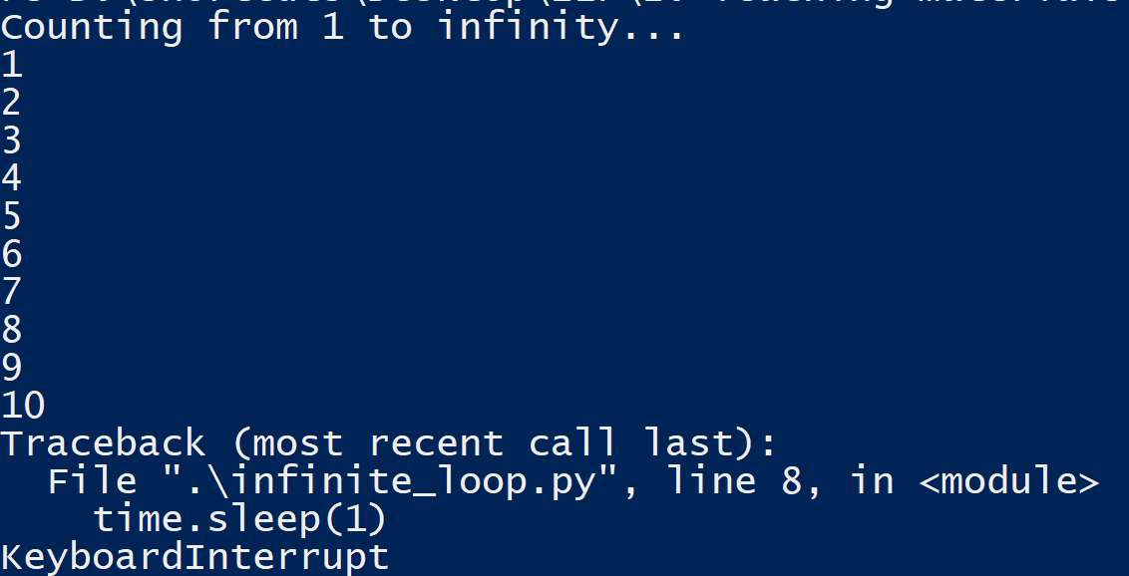
Infinite loops and how to kill them
Infinite loops will keep on executing forever, unless
You decide to crash the program on purpose and kill the loop manually.
This is called a keyboard interrupt. It is done with CTRL+C (or CMD+C on mac), in console mode and most IDEs.

Slide 24
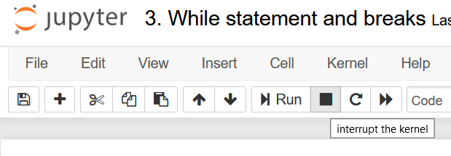
Infinite loops and how to kill them
Infinite loops will keep on executing forever, unless
You decide to crash the program on purpose and kill the loop manually.
This is called a keyboard interrupt. It is done with CTRL+C (or CMD+C on mac), in console mode and most IDEs.
Or, by using the stop button on Jupyter.

Slide 25


Infinite loops and how to kill them
Infinite loops will keep on executing forever, unless
You decide to crash the program on purpose and kill the loop manually.
This is called a keyboard interrupt. It is done with CTRL+C (or CMD+C on mac), if in console mode and most IDEs.
Or, by using the stop button on Jupyter.
KEYBOARD INTERRUPT

Slide 26

Matt’s Great advice #7
Matt’s Great Advice #7: Avoid the infinite loops and dead code, by drawing structural diagrams.
Infinite loops and dead code, unless created on purpose, usually follow from a poor design in your code.
Drawing a structural diagram, before coding, greatly helps figuring out the right structure for your code.

Slide 27
Matt’s Great advice #7
Is the value of x greater than 10?
Yes
No
print(x) and increment x by one
print(“Done.”)
Initialize x as 0
Matt’s Great Advice #7: Avoid the infinite loops and dead code, by drawing structural diagrams.
Infinite loops and dead code, unless created on purpose, usually follow from a poor design in your code.
Drawing a structural diagram, before coding, greatly helps figuring out the right structure for your code.
Example: diagram for our while loop, counting from 1 to 10.

Slide 28
Infinite loops and how to kill them
Infinite loops will keep on executing forever, unless
You decide to crash the program on purpose and kill the loop manually.

Slide 29
Infinite loops: the break statement
Infinite loops will keep on executing forever, unless
You use a break statement.

Slide 30
Infinite loops: the break statement
Infinite loops will keep on executing forever, unless
You use a break statement.
When encountered, the break statement will immediately end the current while loop.

Slide 31
Infinite loops: the break statement
Infinite loops will keep on executing forever, unless
You use a break statement.
When encountered, the break statement will immediately end the current while loop.
The code then resumes its execution with the next line outside of the while block.

Slide 32
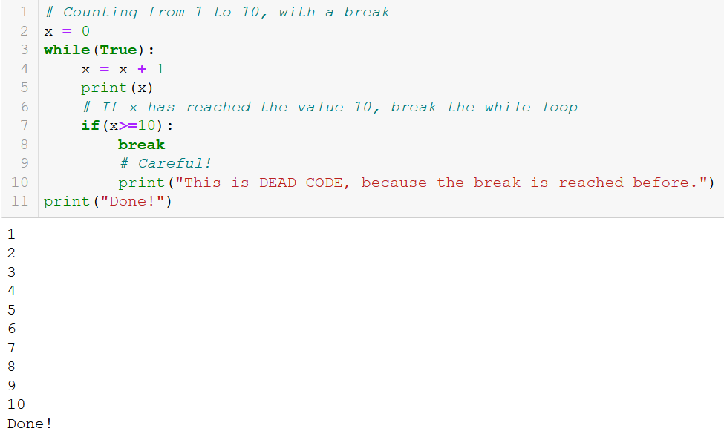
Infinite loops: the break statement
Infinite loops will keep on executing forever, unless
You use a break statement.
When encountered, the break statement will immediately end the current while loop.
The code then resumes its execution with the next line outside of the while block.

Slide 33
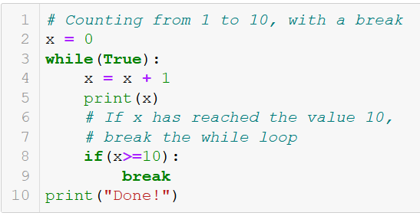
Standard while vs. infinite while + break
Standard while loop with condition in the while statement.
Infinite while loop with condition in an if statement, and break in the if block.
→ Both loops work and do the job, which one is better though?

Slide 34
Matt’s Great advice #8
Matt’s Great Advice #8: Avoid the infinite loops, if possible.
Relying on an infinite while loop with a break is risky, and should be avoided when possible.

Slide 35
Matt’s Great advice #8
Matt’s Great Advice #8: Avoid the infinite loops, if possible.
Relying on an infinite while loop with a break is risky, and should be avoided when possible.
It is often easily avoided, by using the Boolean expression of the if statement used for break, as the condition in the while statement.

Slide 36
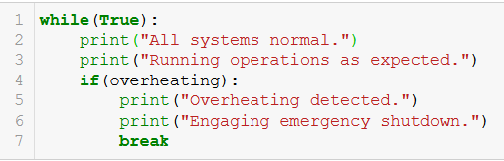
Matt’s Great advice #8
Matt’s Great Advice #8: Avoid the infinite loops, if possible.
Relying on an infinite while loop with a break is risky, and should be avoided when possible.
It is often easily avoided, by using the Boolean expression of the if statement used for break, as the condition in the while statement.
Note: a few cases, however, require the use of a break statement. For instance, emergency shutdowns.

Slide 37
Practice activities for while/break
Let us practice the while/break concepts a bit, with two activities.
Activity 1 – How many hits can you take.ipynb

Slide 38
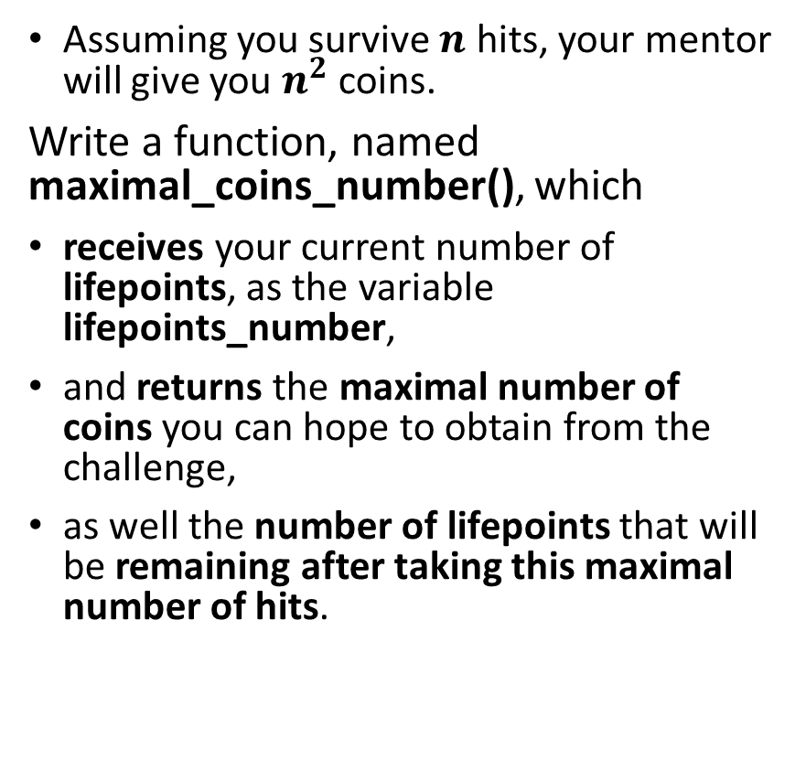
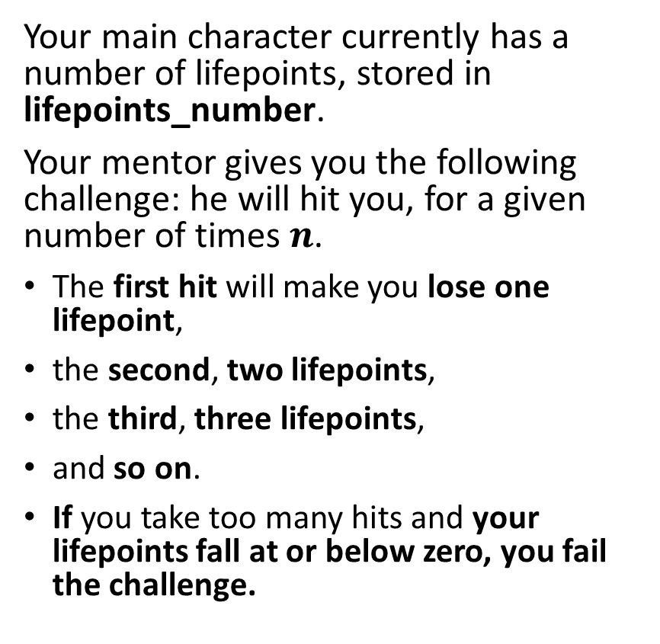
Activity 1 - How many hits can you take
Your main character currently has a number of lifepoints, stored in lifepoints_number.
Your mentor gives you the following challenge: he will hit you, for a given number of times $n$.
The first hit will make you lose one lifepoint,
the second, two lifepoints,
the third, three lifepoints,
and so on.
If you take too many hits and your lifepoints fall at or below zero, you fail the challenge.
Assuming you survive $n$ hits, your mentor will give you $n^{2}$ coins.
Write a function, named maximal_coins_number(), which
receives your current number of lifepoints, as the variable lifepoints_number,
and returns the maximal number of coins you can hope to obtain from the challenge,
as well the number of lifepoints that will be remaining after taking this maximal number of hits.

Slide 39
Activity 2 – Guess the number game v2
Remember the guess the number game in W3S1, Activity 1? Back then, we had defined a function guess_the_number(),
which received a hidden number that the user had to guess (passed as input hidden_number),
asked the user to input a number, via the input() method and would store it in a variable guessed_number,
and based on the two numbers would display two messages, reading:
"You have found the hidden number: True/False."
"Your number in guessed_number is lower than the hidden number: True/False.“
Your task is to write a second version (v2!) of this function, called guess_the_number_v2().

Slide 40
Activity 2 – Guess the number game v2
This v2 function will have the following features, replacing the previous ones:
The game will keep on asking the user to input() values, until the right number is found.
It will display the message "Your have found the right number!", once the user has found the right number.
When that happens, it also displays "It only took you ... tries!" with the blank filled with the number of times the user had to type a number via input().
Once the number has been found, the function no longer asks the user for inputs and stops.
While the user has not found the right number, the game will display either
"Your number is lower than the hidden number." (if the last number entered by the user is lower than the hidden number)
or "Your number is higher than the hidden number." (if the last number entered by the user is higher than the hidden number).

Slide 41
Conclusion
The if statement
The elif statement
The else statement
Dead code and code structure
Nested ifs
While statements
Infinite looks and how to kill them
The break statement
(If time allows, recursion!)

Slide 42
Up for a challenge? (in the Extra challenges folder)
Challenge: Activity 1+ - How many hits can you take (extra challenge).ipynb
Similarly, as in other challenges…
Do not use any conditional statement (if/while)
Hint: use a bit of maths on sequences!

